Slide 1
DIGITAL SIGNAL PROCESSING
Feb-9-2009
Team Finck BIG!
Bryan Finck
David Horne
Carlos Lazo
Rowland Stilwell

Slide 2
Mission
Given customer specifications, our team was entrusted to create a digital receiver to accept two different analog IF signal types, AMPS and IS-95.

Slide 3
Assumptions
Assume that the analog IF signal enters the digital receiver input without any aliasing
Assume that our lowpass filters (LPF) created in MATLAB can be manufactured
Assume that the demodulator will handle the necessary downsampling
The noise on our signal will be White Gaussian Noise
Cabling effects between components can be ignored
Assume there is no loss in the RF Switch

Slide 4
Signal Background
AMPS
  QPSK
  30 KHz Bandwidth
IS-95
  QPSK
  1.288 MHz chip rate

Slide 5
Sampling and Aliasing
Nyquist Rate - minimum sampling rate required to avoid aliasing, equal to twice the highest frequency contained within the signal. (WIKI)
  Our Nyquist Rate would therefore be 2*(max) = 2.576 MHz
We choose to have a requirement of a sample rate of at least 5 MHz, which is greater than the Nyquist rate

Slide 6
System Diagram
DIGITAL RECEIVER
RF Switch
A/D
Converter
LPF (AMPS)
Demodulator/
Buffer
LPF (IS-95)
Digital Down
Converter
(DDC, Oscillator)

Slide 7
COTS A/D Converter
Requirements
  Sample rate of at least at 5 MHz
ADS1610 16-Bit, 10Msps Delta-Sigma Analog-to-Digital Converter from Texas Instruments
  10Msps Output Data Rate (Sample Rate)
  4.9MHz Signal Bandwidth
  16-bit word size
  Center frequency at 16 MHz
http://focus.ti.com/docs/prod/folders/print/ads1610.html
* Converts the analog IF signal into a digital signal sampled at 10Msps, which is greater than the requirement.

Slide 8
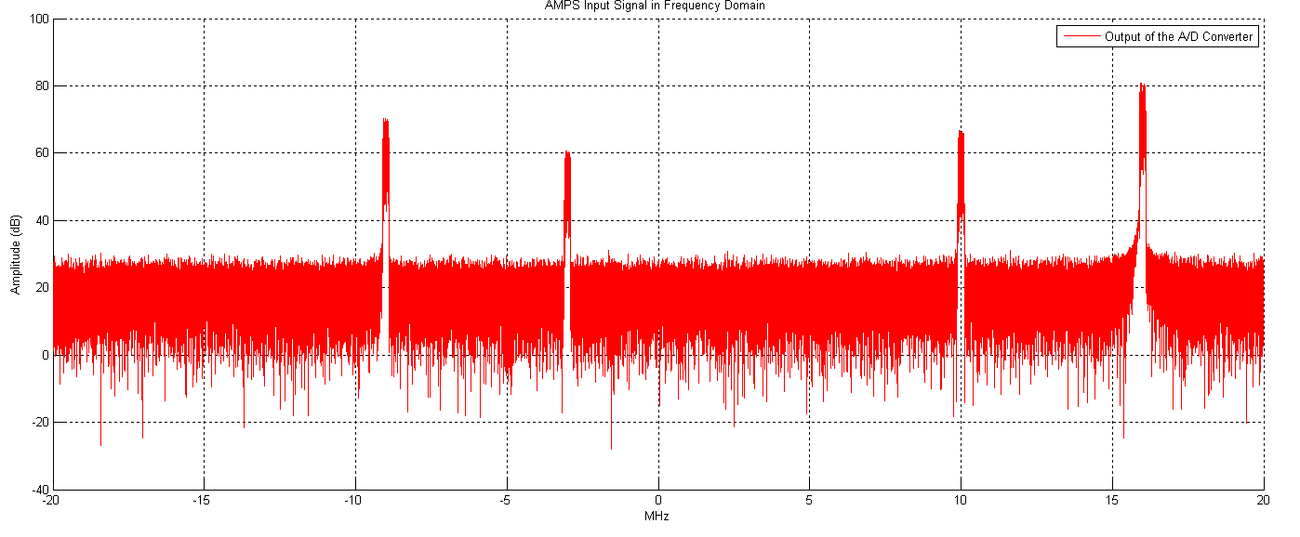
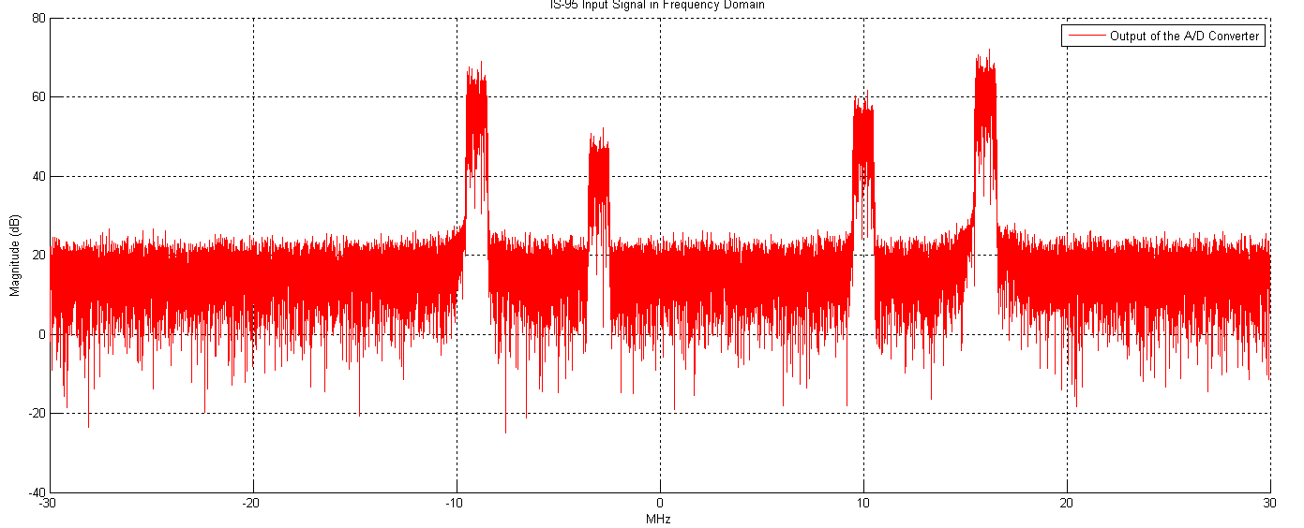
Simulated Digital Signals (Frequency Domain)
AMPS A/D Output:
IS-95 Output:
Signals of interest centered
around 16MHz. Input
simulated with channel noise
and other random signals.

Slide 9
COTS Digital Down-Converter
Requirement
  Sample Rate of at Least 5 MHz
  Down convert capability of at least 16MHz
Mid-Atlantic RF Systems Inc.
  DEM-LM01 Dual Down-Converter (2 Channel)
    Output Frequency 9.216 MHz
    Down sampled factor of 2 due to the number of channels
      Therefore sample rate is 5MHz
    Center frequency is now at baseband 0 MHz
    Word size is 16 bits
    16 MHz is within range to convert to baseband
    Bandwidth of 4.9 MHz
* Down-converts the signal centered at 16MHz to baseband. The sample rate still meets the requirement.

Slide 10
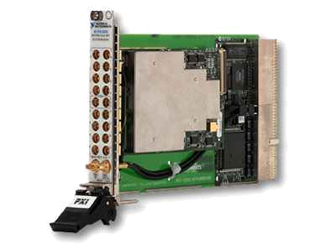
COTS Reprogrammable RF Switch
Requirement
  Switch across a bandwidth of at least 4.9 MHz
NI PXI-2593 500 MHz Multiplexer/Matrix
  Bandwidth 500 MHz
  Center Frequency baseband 0Mhz
  Sample rate of 5 MHz
  Word Size 16 bits
* Branches the different signal types to specialized lowpass filters based on their individual bandwidths

Slide 11
Lowpass Filter
LPF type: Parks-McClellan optimal FIR filter
Order:
  AMPS → 395
  IS-95 →204
    NOTE: High order is based on dB seen of simulated input signal and the attentuation desired for the LPF.
Coefficients:
  Are in attached file: MATLAB_Filter_Coefficients.doc
  * The lowpass filters cut out most of the frequency content contained outside of the signal bandwidth within a certain cut-off tolerance. All other frequencies outside the stopband are severely attenuated.

Slide 12
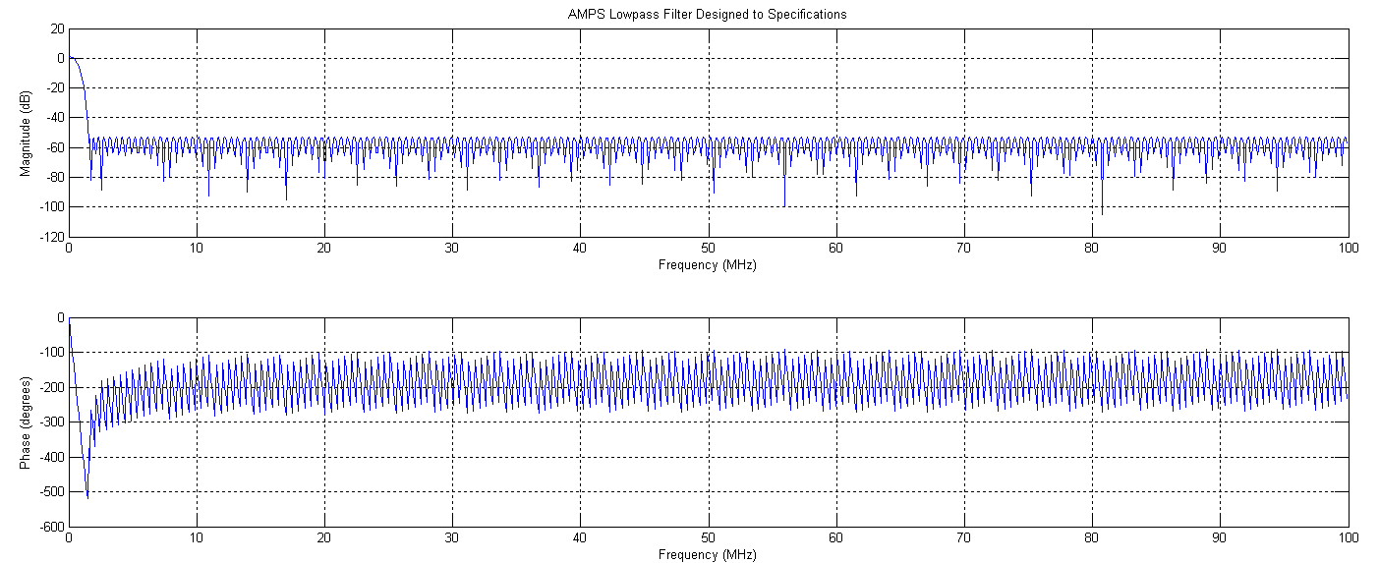
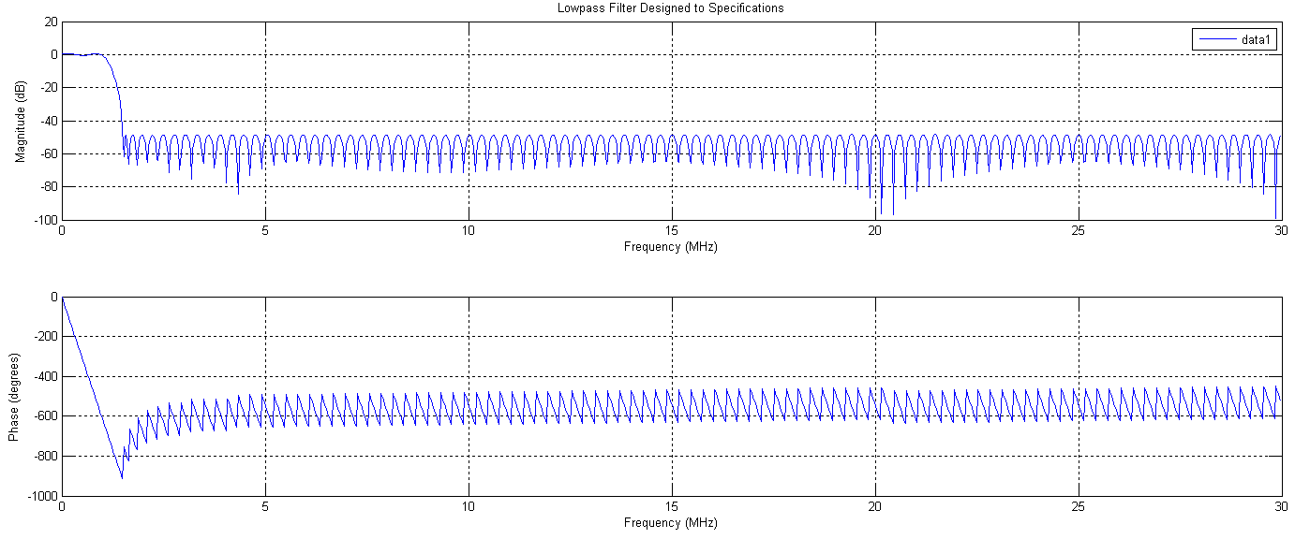
Lowpass Filter from MATLAB
AMPS LPF:
IS-95 LPF:

Slide 13
Output Buffer Estimation
Goal
  30ms of content in buffer
Word (Sample) Size 16 bits
Sample Rate at Output is 5MHz
Calculate storage need per ms
(5*10^6 samples/sec) * (16 bits/sample) * (1 sec/1000ms) =
80000 bits/ms
Total Storage Size Required
(80000 bits/ms) * (30ms) = 2,400,000 bits or 300,000 bytes

Slide 14
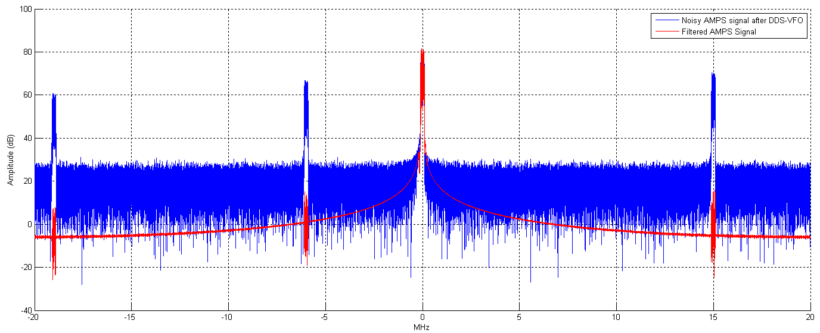
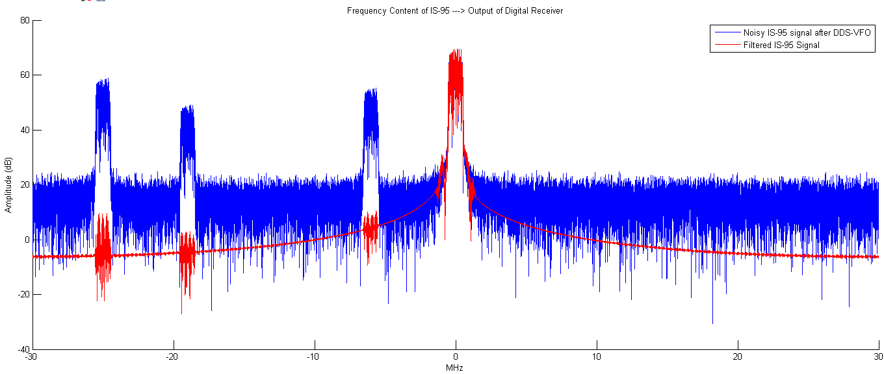
Output Signal
AMPS
Output
Signal:
IS-95
Output
Signal:
Signal is at baseband.
Blue = noisy signal.
Red = SOI after LPF.

